Slide 1





What is Pearl's signature colour in 'Splatoon 2'?
Blue
Black
Green
Pink

Slide 2

Truck
City Car
Bus
Plane
“What is the kind of transportation above?”

Slide 3
Question 1/5
Select Answer Below
Gym
Travel
Game
What’s your plan for the weekend?
Hangout

Slide 4
How do you choose which movie to watch?
a
by the genre
b
by the director
c
by the main star
d
by the synopsis

Slide 5
In which country is ramen a popular food?
China
Thailand
Vietnam
Japan

Slide 6
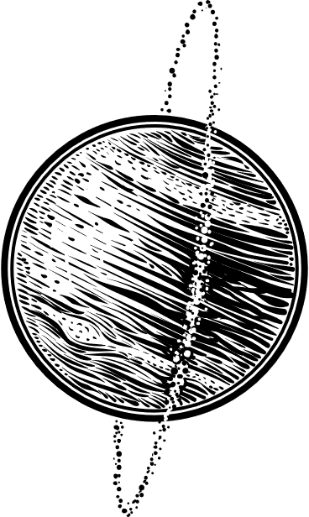



Which planet is closest to the sun?
Jupiter
Saturn
Earth
Uranus
A
B
C
D

Slide 7
H2O is the chemical formula for what?
Water
Oil
Oxygen
Carbon dioxide

Slide 8
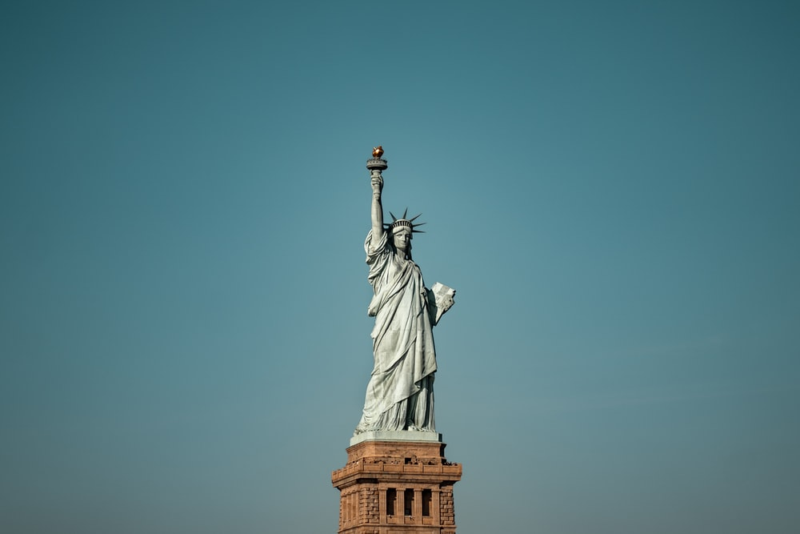
What’s the statues name?
A
Liberty
B
Little Mermaid
C
The Statue of Unity
D
Great Sphinx Of Giza

Slide 9


Which Olympic sport takes place in a velodrome?
A
B
Cycling
Athlethic
C
D
Baseball
Soccer

Slide 10



What is the name of the
toy cowboy in “ Toy Story ? ”
A
B
Woody
Buzz
C
D
Andy
Roocky

